Slide 1
Independent Project
ArduinoConnect
SHIVAM GARG
VIBHOR RAWAL

Slide 2
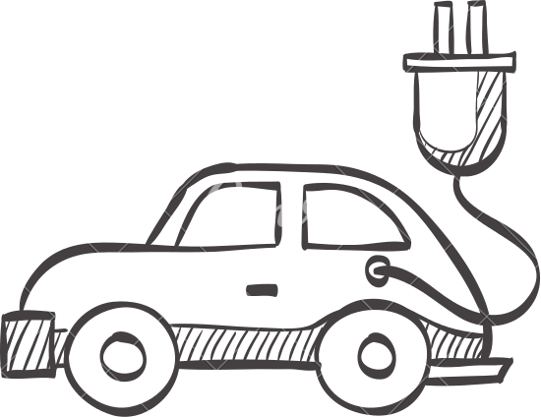

Remote Control Car
UTILISING ANDROID APP STUDIO AND ARDUINO

Slide 3
Android App
The app is used as a remote control for the R/C car.
Layout:
The first layout is connection establishment with R/C car.
The second layout showcases the remote interface to control the car.
Code:
The connections take place via Bluetooth to deliver the commands controlling the R/C car.

Slide 4
Hardware Side
The following constitute its hardware side -
Arduino Uno
Bluetooth Module(HC-05)
LM293D motor driver IC
7805 Voltage Regulator IC
Breadboard, jumper wires, motor, chasis, Batteries, Wheels etc

Slide 5
Software Side
The following constitute its software side -
Arduino Sketch
Bluetooth Transmission (RFCOMM protocol)
Android App
Serial Communication through App

Slide 6
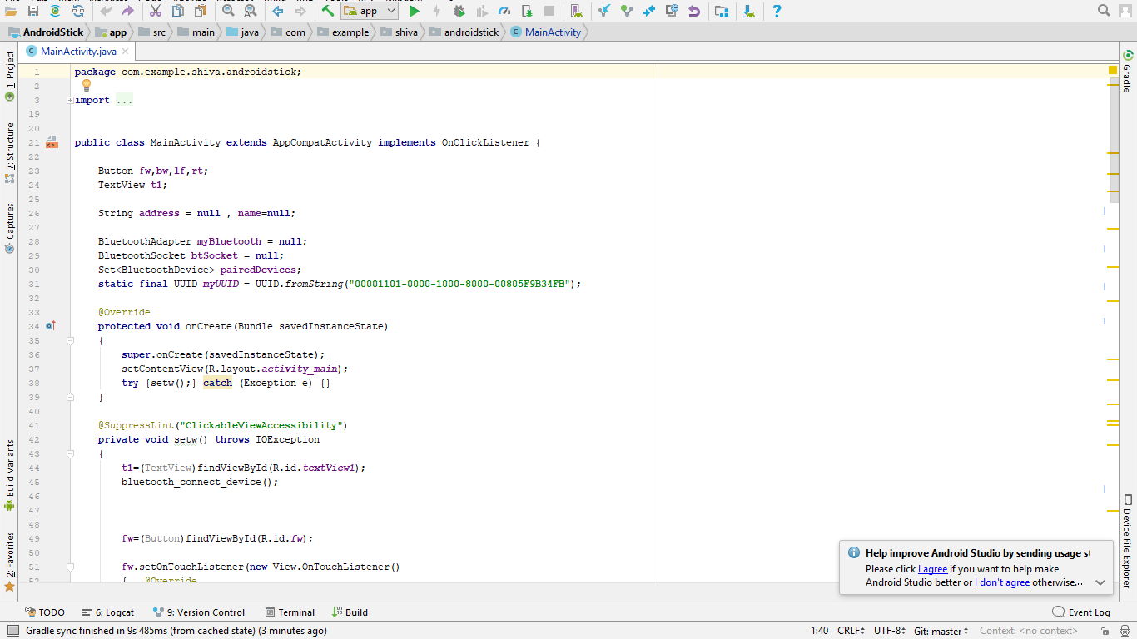
Software Side

Slide 7
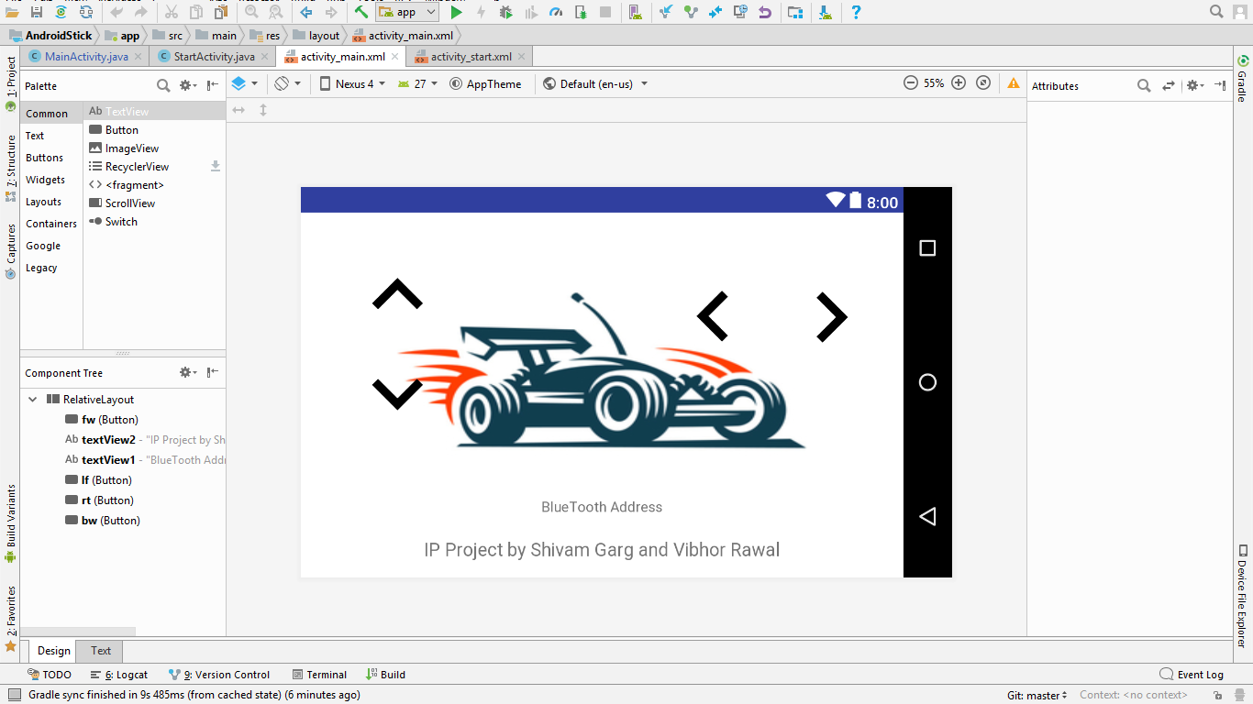

Slide 8
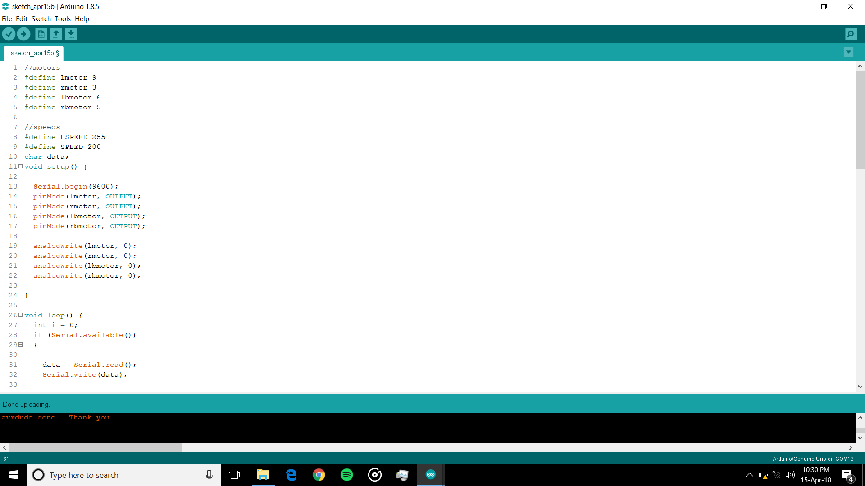

Slide 9

BLUETOOTH APP FUNCTIONALITY

Slide 10
OUR EXPERIENCE
It was a great journey of 4 months while Developing this Bluetooth controlled Arduino based RC Car
We went through various Online Video lectures for learning the Coding of Bluetooth module on Arduino Uno board and the Board itself.
The Challenges that we faced were worth a lot...Helped us to learn Debugging and Effective Implementation Skills throughout our Project.

